Slide 1
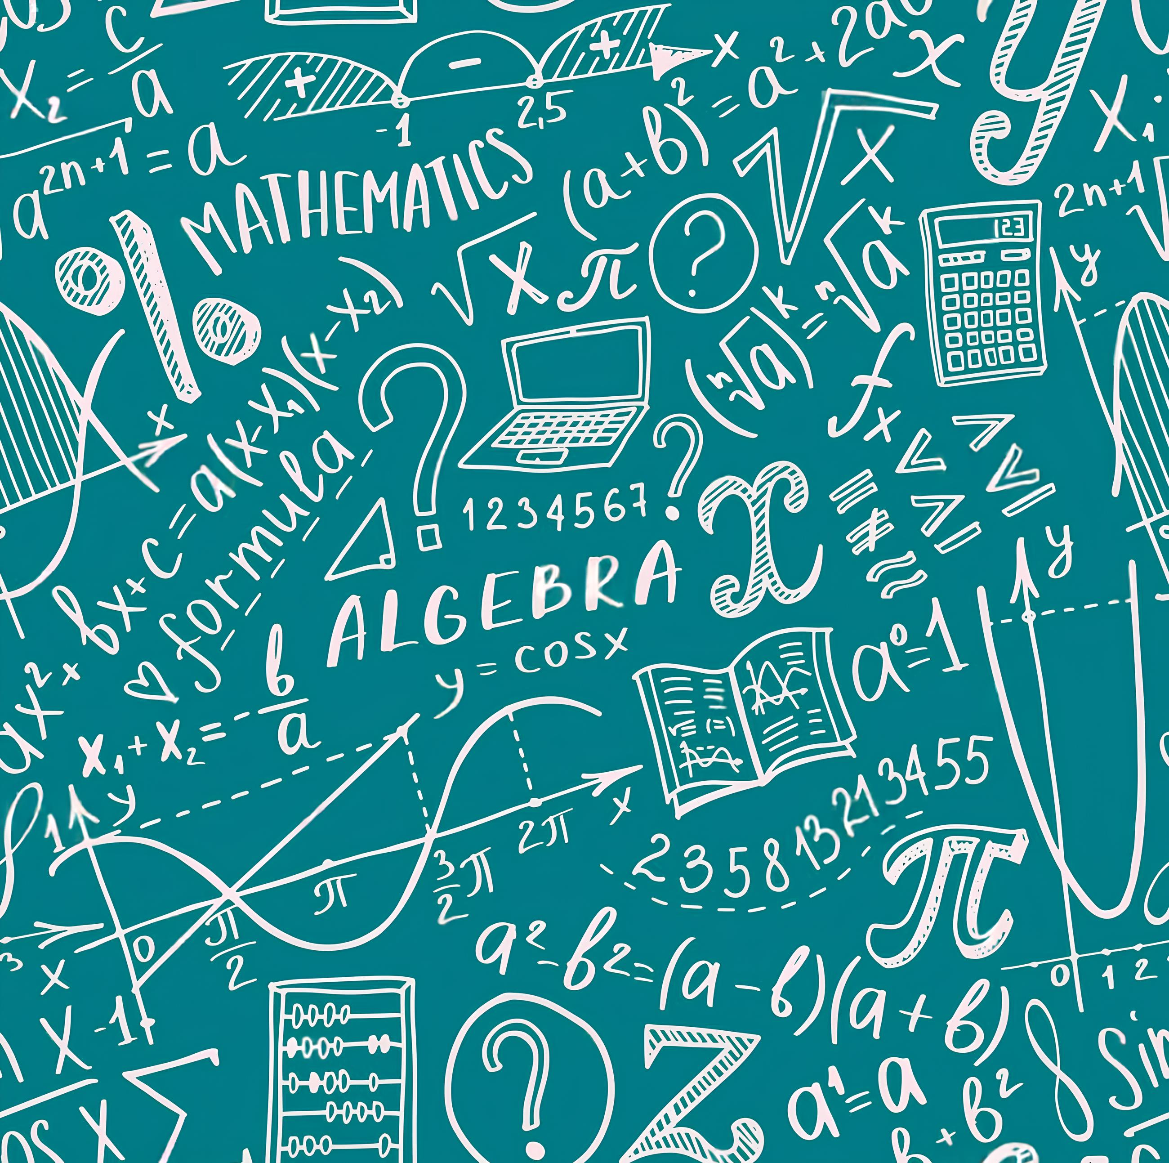
Algebra
With Mr. Kelly

Slide 2
1
3
5
7
19
Step 1
Step 2
Step 3
Step 4
Step 10

Slide 3
1
3
5
7
19
…
Step 1
Step 2
Step 3
Step 4
Step 10
“Twice the step number, take away 1”
For Step n there are 2 × n - 1
“2n -1”

Slide 4


2n -1
Pronumeral (or Variable):
A letter (like x, n, a) that represents a number whose value is unknown or can change
Expression: A mathematical phrase that contains numbers, pronumerals, and operation signs (like +,−,×,÷), but no equals sign. It doesn't state equality.
Examples: n+5, 3x, 2y−7

Slide 5
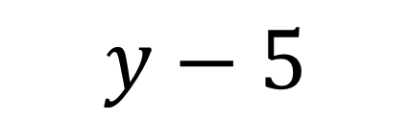
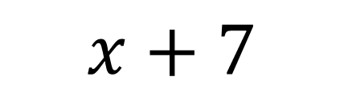


Examples
A number increased by 7
$$x+7$$
5 less than another number
$$y−5$$
Double the amount
$$2a$$
The quantity halved
$$\frac{q}{2}$$

Slide 6
🍓
🍍
🍓
🍍
🍎
🍎
🍎
🍎
🍎
🍎
🍎
What fruit do I have?
🍎
🍎
🍎
🍊
🍊
🍊
🍊
🍊
🍊
2 🍎 + 1 🍍 + 3🍊 + 3 🍎 + 1 🍓
5 🍎 + 1 🍍 + 3🍊 + 1 🍓
5 Apples + 1 Pineapple + 3 Mandarins + 1 Strawberry
5a + 1p + 3m + 1s
Simplification
5a + p + 3m + s

Slide 7
Simplification
3a+2a
5x+4+2x
7y−3y+1
3e + e
8i + 2 - 3i - 2
5a (think 3 apples + 2 apples → 5 apples)
7x + 4
4y + 1
4e
5i

Slide 8




Think Pair
Share
$$4a+5−7a+6$$
$$8x+4+6x −9$$
$$5b+3f+4−2b+8f−7$$
$$5xy+3y−4−2xy−8y+6x$$

Slide 9











$$4a$$
$+$ 5
$$−7a$$
$$+ 6$$
$$4a+5−7a+6$$
$$−3a+11$$
$$8x+4+6x −9$$
$$14x−5$$
$$5b+3f+4−2b+8f−7$$
$$3b+11f−3$$
$$5xy+3y−4−2xy−8y+6x$$
$$3xy−5y+6x−4$$

Slide 10



Translate into Expressions and Simplify Like Terms.
1: A baker makes ‘c’ cakes on Monday and twice that number on Tuesday. Write a simplified expression for the total number of cakes made over the two days.
2: A t-shirt costs $15. You buy ‘t’ t-shirts and then use a $5 discount coupon,
Write an algebraic expression for the total cost.
3: Sarah shared ‘d’ doughnuts equally among her 4 friends.
$$c+2c=3c$$
$$15t−5$$
$$\frac{d}{4}$$

Slide 11
Exit Ticket
Take one slip of paper
Write your name clearly at the top
Answer the two questions
When you're done, please hand it to me as you leave

